Slide 1

Data Communication and Networking (ITPC-205)
Data Link Layer
Error Detection and Correction

Slide 2

Error Detection and Correction
Networks must be able to transfer data from one device to another with complete accuracy.
Data can be corrupted during transmission.
For reliable communication, errors must be detected and corrected.
Error detection and correction are implemented either at the data link layer or the transport layer of the OSI model.
Types of error: Single-bit error and burst Error

Slide 3

Single-bit error
In a single-bit error, only 1 bit in the data unit has changed.
Figure: Single –bit error

Slide 4

Burst error
A burst error means that 2 or more bits in the data unit have changed.
Figure: Burst error of length 8

Slide 5
Example:
The number of bits affected depends on the data rate and duration of noise.
If data is sent at rate = 1Kbps then a noise of 1/100 sec can affect 10 bits.(1/100*1000)
If same data is sent at rate = 1Mbps then a noise of 1/100 sec can affect 10,000 bits.(1/100*10⁶)

Slide 6
Error detection
Error detection means to decide whether the received data is correct or not without having a copy of the original message.
Error detection uses the concept of redundancy, which means adding extra bits for detecting errors at the destination.

Slide 7
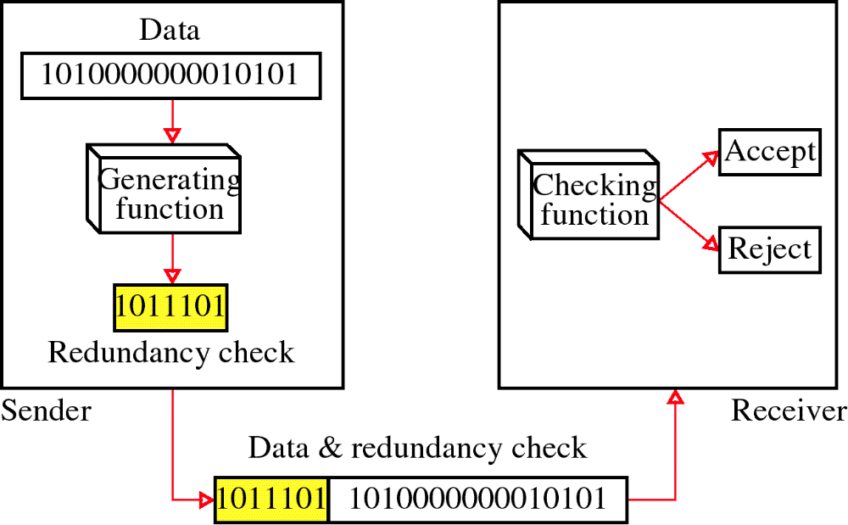
Redundancy

Slide 8
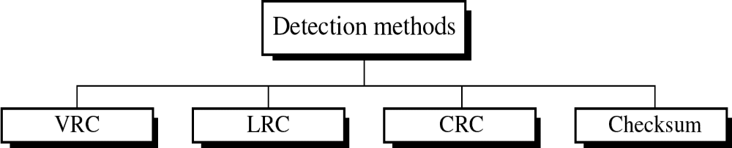
Detection methods
Four types of redundancy checks are used in data communications

Slide 9
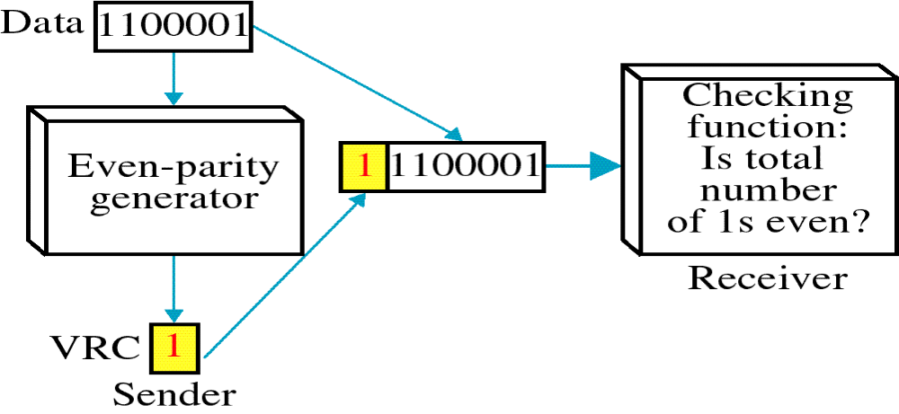
Vertical Redundancy Check (VRC)
It can detect single bit error
It can detect burst errors only if the total number of errors is odd.

Slide 10
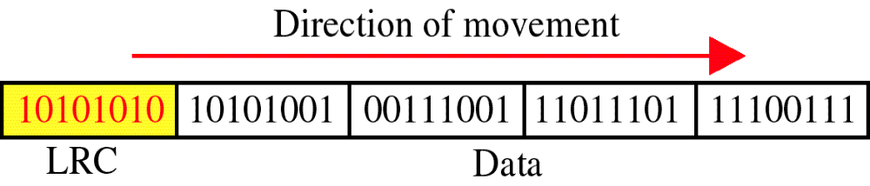
Longitudinal Redundancy Check (LRC)
If two bits in one data units are damaged and two bits in exactly the same positions in another data unit are also damaged, the LRC checker will not detect an error.
Eg. Two data units are 11110000 and 11000011. If the first and last bits in each of them is changed. The data units are 01110001 and 01000010 and error cant be detected.

Slide 11
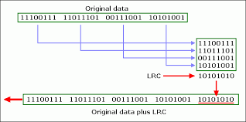
LRC

Slide 12
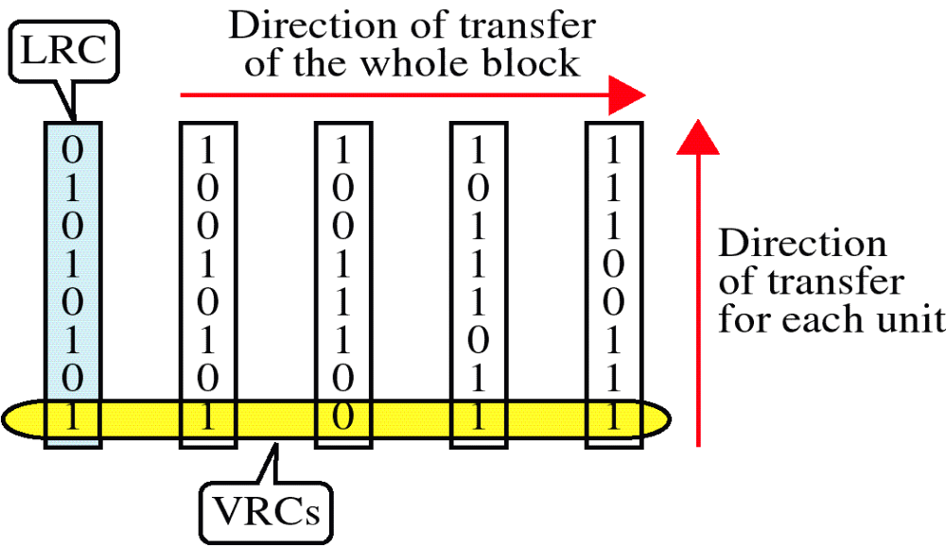
VRC and LRC

Slide 13
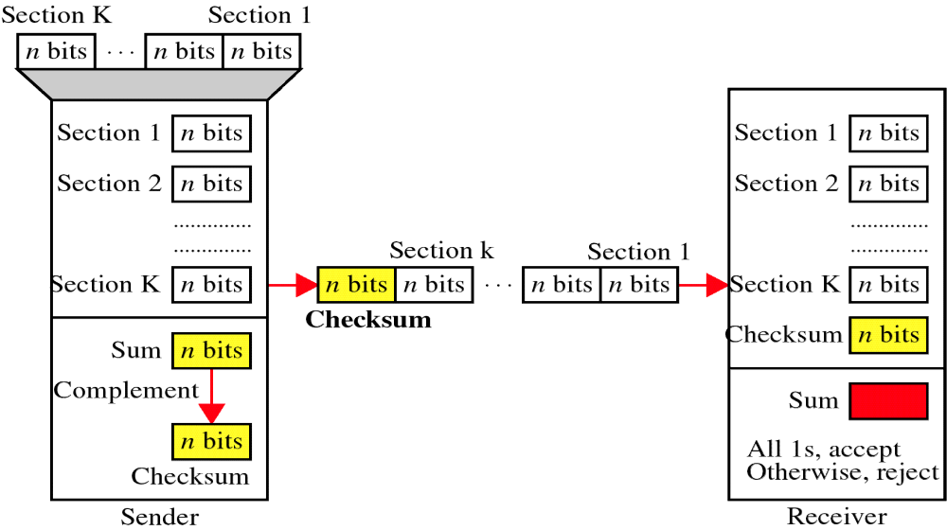
Checksum

Slide 14
At the sender
The unit is divided into k sections, each of n bits.
All sections are added together using one’s complement to get the sum.
The sum is complemented and becomes the checksum.
The checksum is sent with the data

Slide 15
At the receiver
The unit is divided into k sections, each of n bits.
All sections are added together using one’s complement to get the sum.
The sum is complemented.
If the result is zero, the data are accepted: otherwise, they are rejected.

Slide 16
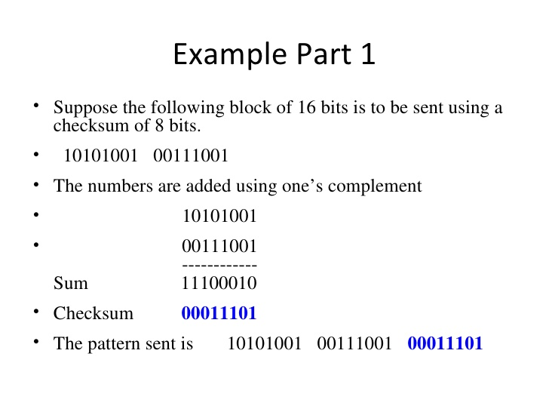

Slide 17
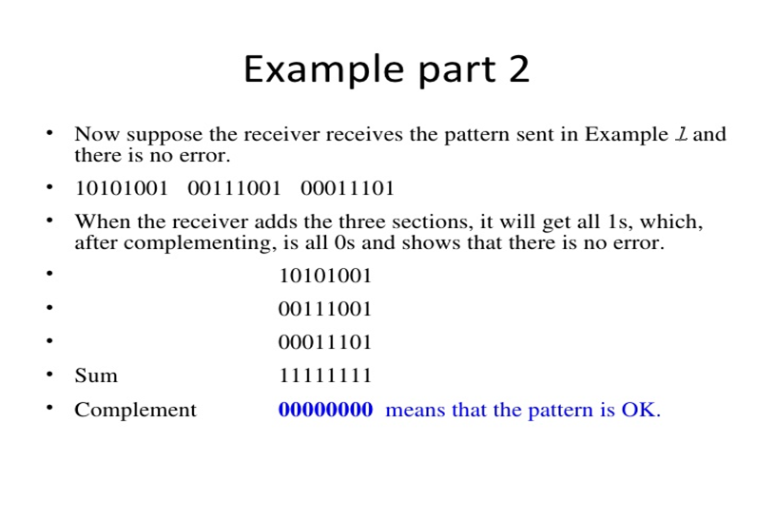

Slide 18
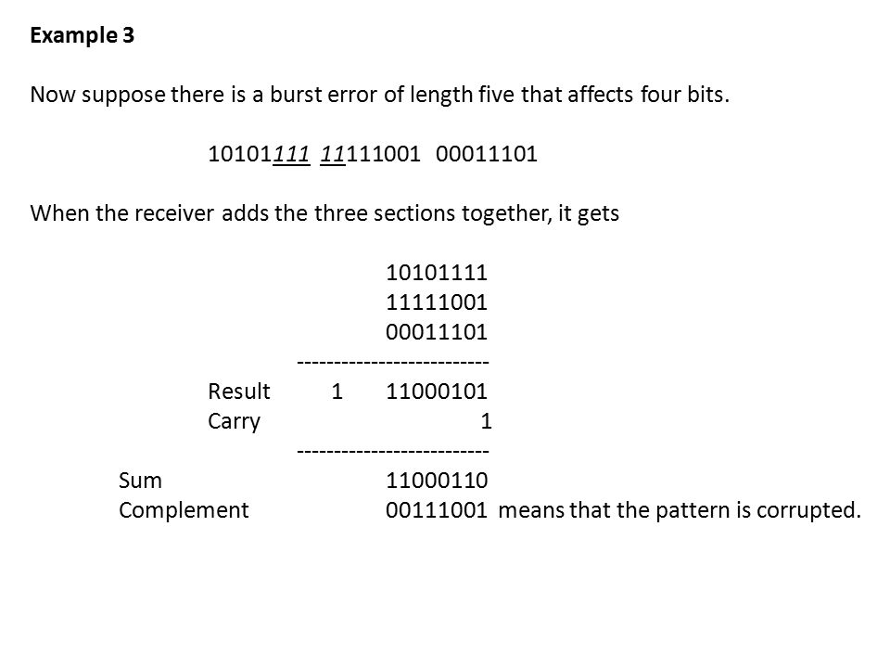

Slide 19
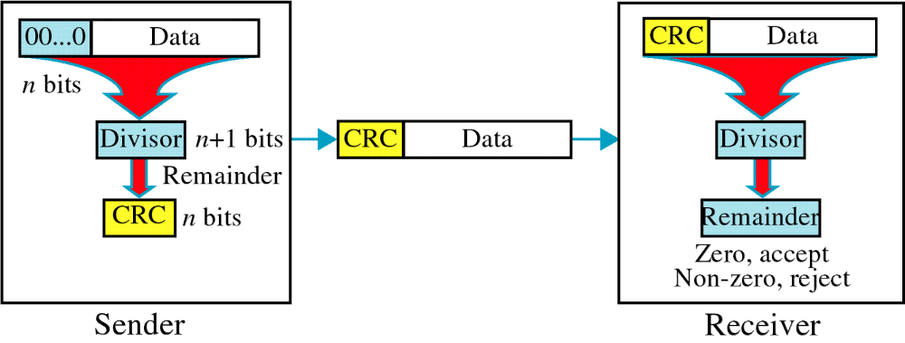
Cyclic Redundancy Check (CRC)

Slide 20
Cyclic Redundancy Check
Given a k-bit frame or message, the transmitter generates an n-bit sequence, known as a frame check sequence (FCS), so that the resulting frame, consisting of (k+n) bits, is exactly divisible by some predetermined number.
The receiver then divides the incoming frame by the same number and, if there is no remainder, assumes that there was no error.

Slide 21
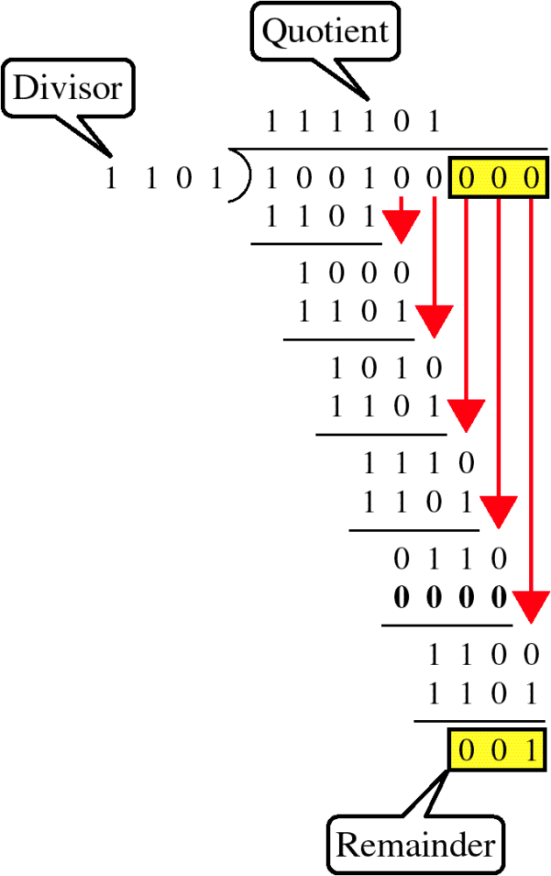
Binary Division

Slide 22
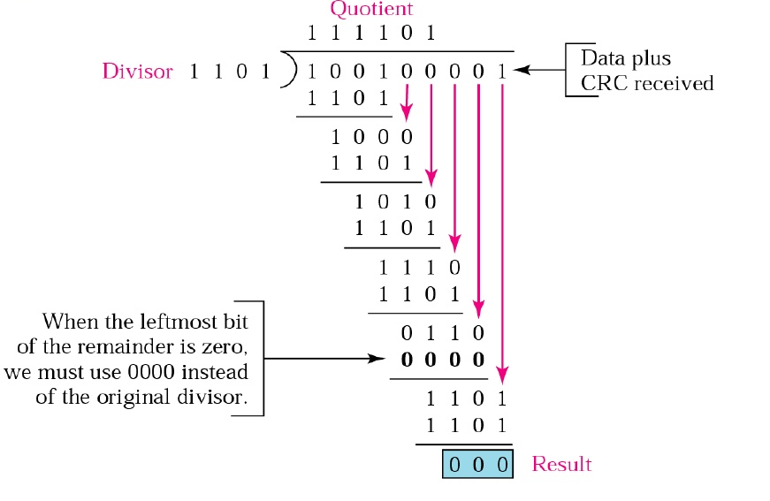
Binary Division

Slide 23
Error Correction
It can be handled in two ways:
    Receiver can have the sender retransmit the entire data unit.
    The receiver can use an error-correcting code, which automatically corrects certain errors.
    Single-bit error correction
        To correct an error, the receiver reverses the value of the altered bit. To do so, it must know which bit is in error.

Slide 24
Hamming Distance
The hamming distance between two words is the number of differences between corresponding bits
The hamming distance can easily be found if we apply XOR operation and count the number of 1.
two pair of words are given d(0011, 0101)
Hamming distance is: 2
Bennett University

Slide 25
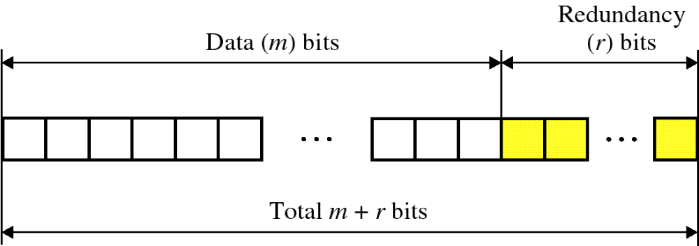
Hamming Code
Number of redundancy bits needed
Let data bits = m and redundancy bits = r
∴Total message sent = m+r
The value of r must satisfy the following relation:
2^{r} ≥ m+r+1

Slide 26
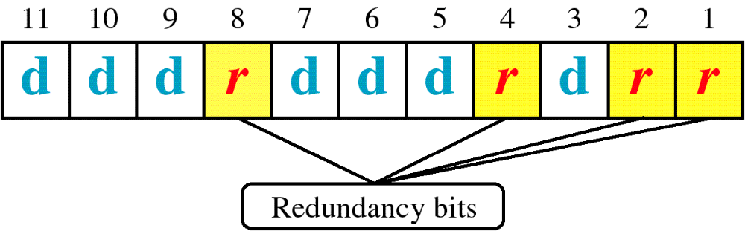
Hamming Code

Slide 27
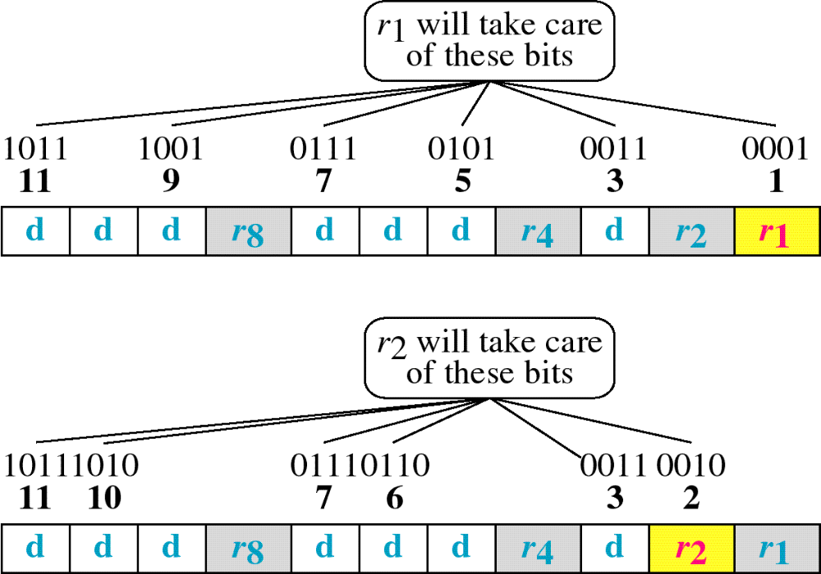
Hamming Code

Slide 28
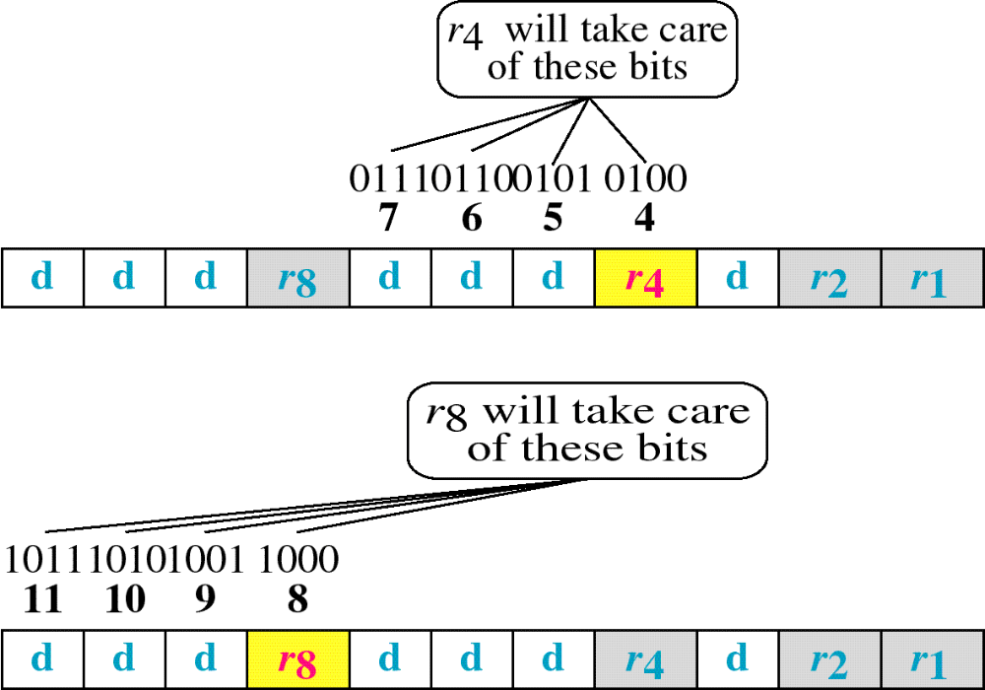
Hamming Code

Slide 29
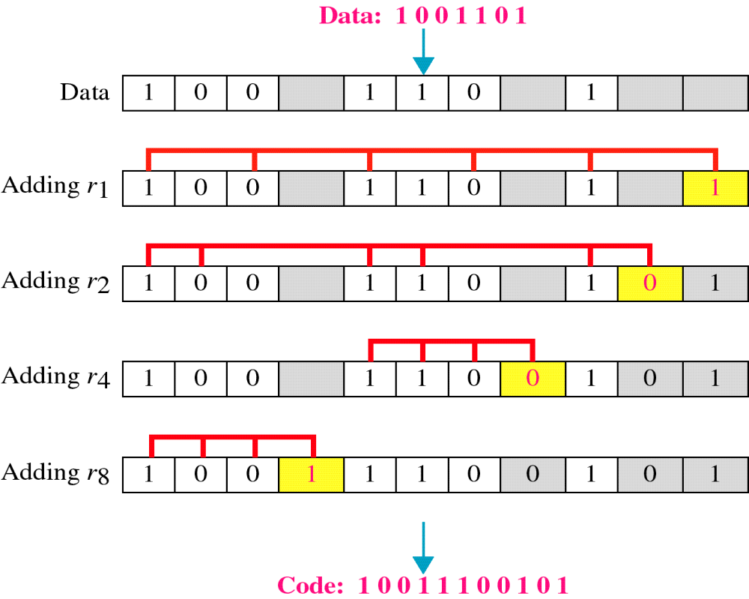
Example of Hamming Code

Slide 30
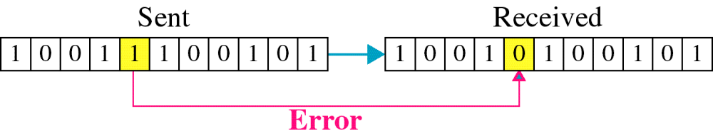
Single-bit error

Slide 31

Error Detection

